Slide 1
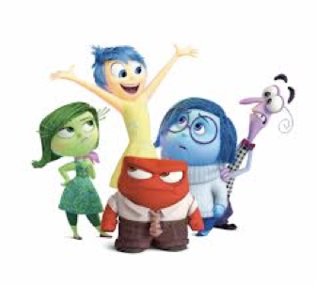
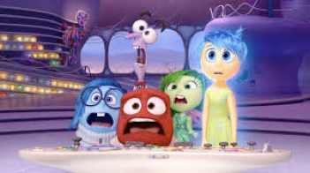
EMOTION SCIENCE
Psyc 3310
Tutor: Yong Zhi Foo
yong.foo@uwa.edu.au (no regular office hours)

Slide 2
Lab 4
Recruiting and Testing Participants
AKA “How not to screw up your study!!!”

Slide 3
What will we be covering today?
Importance of your study
How error affects the quality of your study
How to reduce error during recruitment and testing?
Q&A for research proposal

Slide 4
Your study is important
It is not
  “just” a 310 project
  “just” about your learning or your grades
It is
  about trying to find out something new!
  and is important enough to take up your participants’ time
  it may well end up as published research
Though this is kind of important ☺

Slide 5
The quality of your study
Depends on
  Quality of your research design
    e.g., design determined by theory, confounding variables considered etc
  Quality of your materials
    e.g., measures with good reliability and validity
  Quality of the data you collect
    e.g., error/noise, external validity problems
✔
✔
?

Slide 6
Error in your data
Remember, all measurement contains error
More random error in your data means
    less reliability
    more variance
    more difficulty finding significant effects
    more difficulty drawing conclusions from your results
Systematic error is even worse, unless you’ve got a measure of it

Slide 7
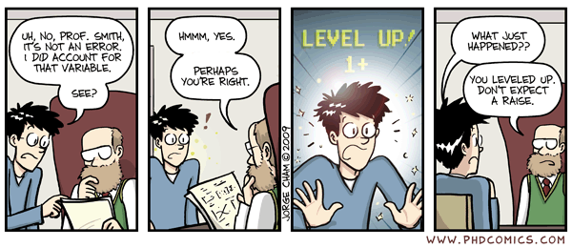
So how do we reduce error??

Slide 8
Recruiting participants
You will be recruiting 6 participants each
Things to take note:
  Lack of pressure on potential participants
    Reward e.g. money, treats, etc.
    Threats
  Are we targeting specific groups of individuals?
    Age (> = 18 for your study)
    Ethnicity?
      Only people who have spent > 5 years in a Caucasian majority country
        Why?
        How do we define Caucasian?
Recall: Ethical principle of respect covered last week

Slide 9
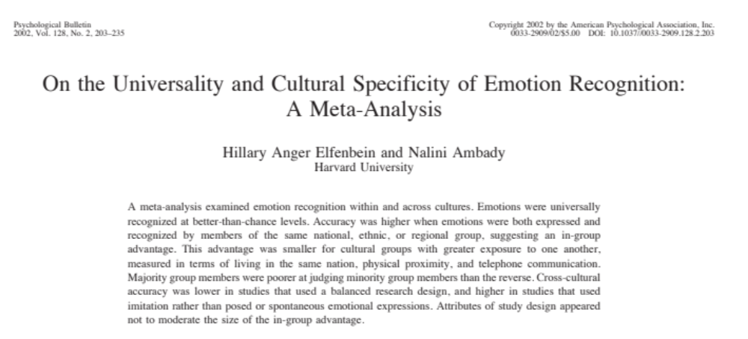

Slide 10
Recruiting participants
Recall: Ethical principle of respect covered last week
Lack of pressure on potential participants
  Reward e.g. money, treats, etc.
  Threats
Are we targeting specific groups of individuals?
  Age (> = 18 for your study)
  Ethnicity?
    Only people who have spent > 5 years in a Caucasian majority country
    How do we explain to potential participants?
      Some people might think that we are discriminating against specific groups of people. If you encounter such a situation, remain calm and respectful 😊
      Explain that we are limiting our participants to specific groups of individuals for experimental reasons (e.g. potential other race effect)

Slide 11
Tips for working with participants
Try to minimise the sources of “error” in the data you get from participants
  Remember your experiences as a 1st year!!
    How good was the data you provided?
    How were you treated?
  Treat participants with respect & courtesy and as a person “doing you a favour”

Slide 12
Tips for working with participants
  Engage the participant
    Be interested in them
    Encourage them to see you as a person, a fellow student and someone they don’t want to screw over!
    Be enthusiastic about your project!
    Be serious about your project
    If your tasks are boring/difficult/silly you can acknowledge this
      but give impression this is a NECESSARY evil

Slide 13
Tips for working with participants
Pro Tip: People’s responses to stimuli they don’t see aren’t very informative!
    Be vigilant!
    Check that they can see!
      e.g., should they be wearing their glasses?
      e.g., is there a horrible glare from an overhead light obscuring something on the screen?
    Ask them to put phone on silent and put it out of sight
    Observe your participant, are they concentrating/dozing off/button bashing/not looking well etc.?

Slide 14
Tips for working with participants
    Be as consistent as possible
    Every testing session should be as similar as possible
    Order in which you all do everything should be the same
      except where varied for specific reasons, e.g. counterbalanced task order
    Instructions should be identical for all participants
      instructions presented on computer screen help
      prepare a script for verbal instructions
  Why is consistency super important when measuring individual differences?

Slide 15
Tips for working with participants
  Debrief seriously
  Participants often keen to escape
  Find quick way to give them a sense that your study is looking at something interesting and that their time hasn’t been wasted
  Ask them not to explain experiment to other potential participants
  Sometimes need to check whether have
    completed any of the tests/questionnaires before
    participated in any similar studies e.g., run by the Facelab/PEPLab

Slide 16
Keeping good records
  This data may have a life well beyond your 310 project! Make everything comprehensible to others
  We will program all the tasks using the online testing software Qualtrics
    Advantages – Data matching, randomization, etc. are all automated
    Details to be covered next week
  Record important demographic details
    We will have a demographic questionnaire at the end of the study for the participants to fill in, e.g., Age, Gender, Ethnicity (years in Oz)
  Record observations of participants
    e.g., not interested and didn’t appear to try hard, arrived late & was flustered, had trouble understanding task, did everything very quickly

Slide 17
No blame culture!
Science relies on the integrity of the data
  If something goes wrong when you are testing let me/Romina know
    e.g., computer freezes, dies, does something weird
  If you make a mistake let me/Romina know
    e.g., forget to administer a task, screw up codes, give the wrong instructions, save the data in the wrong place, test a participant who is too old/young
  If there is any reason why we shouldn’t use your participant's data let me/Romina know
    e.g., participant is drunk
Don’t worry! Everyone makes mistakes.
Your marks will not be affected!
You will not have to test additional participants
We rely on your honesty and integrity

Slide 18
What have we covered today?
Importance of your study
How error affects the quality of your study
How to reduce error during recruitment and testing?
Next week……
Details about scheduling and testing for your study
Introduction to the lab space, testing demo, and practice runs (Yay!!)

Slide 19
Research participation swap
To facilitate recruitment, the 3310 class in the face group (Topic 4) has kindly agreed to do a research participation swap.
You can swap with one student in that group and participate in each other’s study.
They are recruiting Caucasians only.
They only have 14 students (maybe less depending on our recruitment criteria). So for those who would like to swap, send me an email by next Monday. Their tutor Jemma and I will match you to one person from that class. First-come-first-serve!

Slide 20
Q&A for research proposal
Notes:
Take general questions, then go around to answer questions specific to each group

